Slide 1
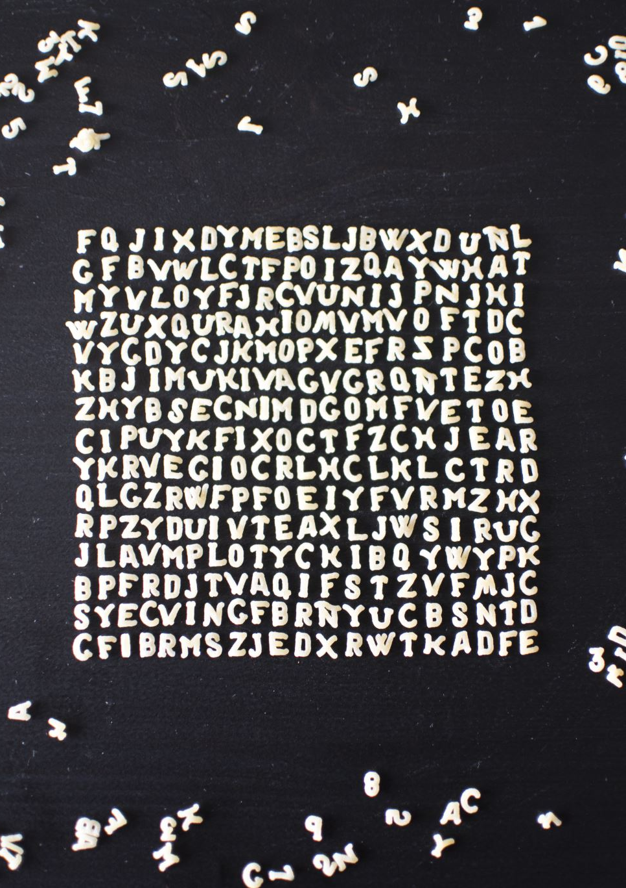
Image-Based Text Steganography Using Basic Python
Student Name & ID: Youssef Ahmed Mahmoud Ahmed, 202401268
Coursework Title: Steganography Application – Python Implementation
Date: 14/12/2025

Slide 2
What is Steganography?
Definition: "Hidden Writing" - concealing information within other data
Vs Cryptography:
Cryptography: Scrambles message (obvious communication)
Steganography: Hides existence of communication

Slide 3
Project Overview
Goal: Hide text messages within BMP images using pure Python
Key Requirements:
No external libraries
Support encoding & decoding
Robust error handling
User-friendly interface
Technical Approach: LSB (Least Significant Bit) substitution

Slide 4
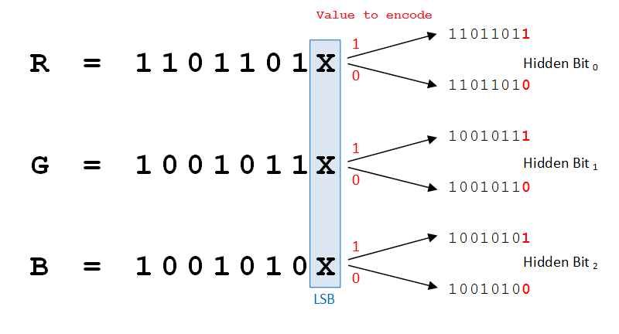
How LSB Steganography Works
Concept: Modify least significant bits of image data
Visual Impact: Human eye cannot detect 1-bit changes
BMP Advantage:
  Lossless format
  Simple structure
  24-bit = 3 bytes per pixel (B, G, R)
Capacity: Each pixel can store 3 bits (one per channel)

Slide 5

System Architecture
Encoding Flow:
  Validate inputs (ASCII, file types, capacity)
  Convert message to binary + null terminator
  Read BMP file, skip 54-byte header
  Replace LSBs with message bits
  Save modified BMP

Slide 6
Key Features
Complete Implementation: Encoding & decoding in one tool
Input Validation:
ASCII character checking
BMP format verification
Capacity checking
File existence checks
Error Handling: User-friendly error messages
.txt File Support: Can read messages from text files

Slide 7
Technical Implementation
Pure Python: No external dependencies
Key Functions:
stega_encode(): Hides message in image
stega_decode(): Extracts hidden message
user_interface(): for interaction
File Operations: Binary read/write operations

Slide 8
Time Complexity
Encoding: O(n) where n = message length in bits
Decoding: O(k) where k = bytes until null terminator

Slide 9
Challenges & Solutions
Challenge | Solution
BMP header corruption | Skip first 54 bytes
Message capacity limits | Calculate available space before encoding
Non-ASCII characters | Validate and reject during input
File format issues | Check BMP signature
Same input/output paths | Enforce different filenames

Slide 10
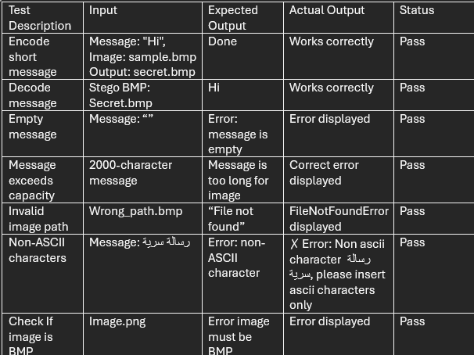
Testing & Validation

Slide 11
Demonstration

Slide 12
Q&A
Questions?
Contact Information: Ya2401268@tkh.edu.eg
GitHub Repository Link: https://github.com/Youusseff55/Steganography-Project.git
Thank You!

